Slide 1
Coursera Project
Battle of Neighborhood
April, 2021

Slide 2
Overview
Toronto is recognized as the most diverse city in the world.
According to official data, over half of the city's residents were born outside of Canada.
About 51% of the residents belong to visible minority, out of which 12.5 are chinese.
Toronto is a highly populous city and any business can flourish easily if certain factors are measured correctly.

Slide 3
Understanding the problem
Item 1
Item 2
Item 3
People often open a new business without analyzing the high demand area and it then results in a failure.
Due to multicultural city, the demand of a specific type of business varies in different areas.
People looking for some specific business or service needs to know the best area to look for it.

Slide 4
Project objective:
To find the best neighborhood in Toronto to open a chinese restaurant.

Slide 5
Target audience
People looking for a chinese restaurant.
People looking to open a new chinese restaurant.
Businessman looking to buy a franchise of a chinese restaurant.

Slide 6
Data acquisition and cleaning
Wikipedia - List of postal codes, boroughs and neighborhoods of Toronto from https://en.wikipedia.org/wiki/List_of_postal_codes_of_Canada:_M.
This contains the list of Toronto, its boroughs and neighborhoods which will be identified with postal codes. It will be cleaned and only those neighborhoods which are in Toronto borough will be extracted.
Geospatial data - A csv file from 'https://cocl.us/Geospatial_data' will be used to get latitude and longitude coordinates of each neighborhood. This will help in finding the exact location of venues.
Foursquare API - It will be used in listing the venues of each location in the radius of 500 kms and in determining the location where a chinese restaurant has more demand and less competition.
35
25
22

Slide 7
Methodology
Following steps are taken to achieve the objective:
Cleaning into dataframe
Getting the location coordinates
Extracting only data of Toronto
Using Foursquare API to get venues of each neighborhood in Toronto at 500 km radius
Extracting data for venue category of ‘Chinese Restaurant’
Merging the previous data frame with that of Chinese Restaurant.
Used kmeans clustering and visualized with folium
Each cluster is then examined separately.
Bar chart is used to visualize maximum number of chinese restaurants in each neighborhood.
Conclusion is drawn.
35
25
22

Slide 8
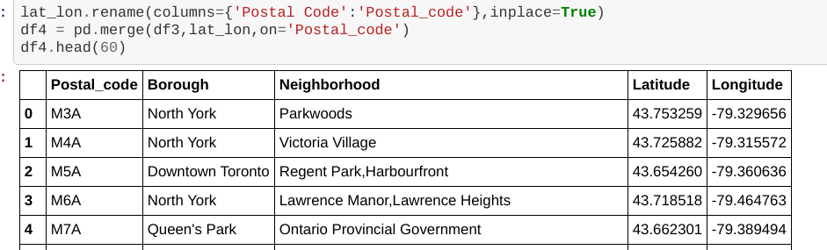
Extracting and cleaning
Data from wikipedia is cleaned and formatted into a dataframe using beautiful soup. It then contains three columns: Postal_code, Boroughs and Neighborhood.
Geospatial data is then stored in a dataframe and merged into the above dataframe. The new dataframe now contains latitude and longitude coordinates of each neighborhood.
35
25
22

Slide 9
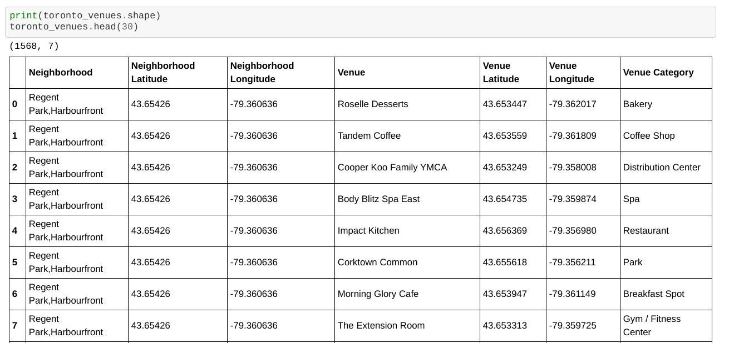
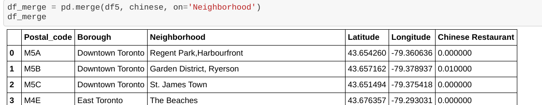
Using Foursquare API
Foursquare credentials are defined
Venues for each neighborhood in Toronto are listed:
One hot encoding is used to represent the categorical data.
Only neighborhoods with venue category of chinese restaurants are extracted from one hot encoding dataframe and merged with the Toronto dataframe to get only those neighborhood with chinese restaurant:
35
25
22

Slide 10
Visualization
Folium is used to view the neighborhood with chinese restaurants on map and also to show the clusters on the map.
Elbow plot with mean squared error is used to find the optimal value of k for clustering.
Bar chart is used to show the maximum number of chinese restaurants in each neighborhood.
35
25
22

Slide 11
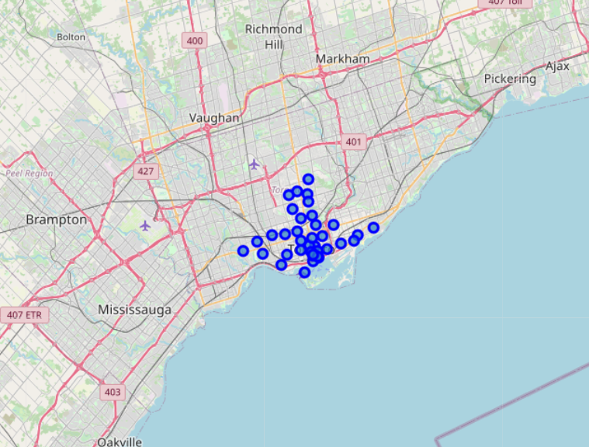
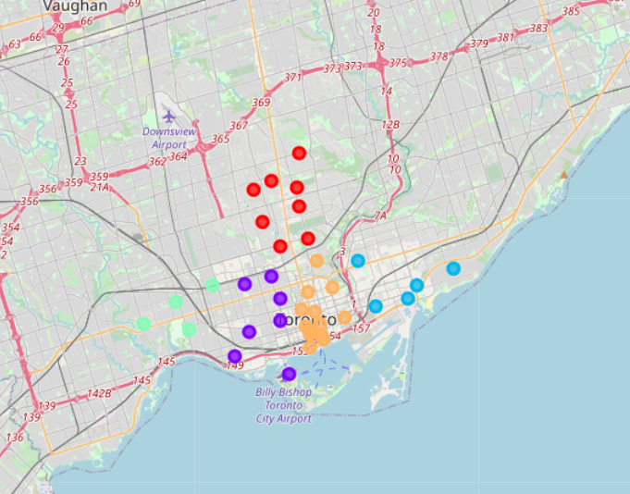
Visualization on map
35
25
22

Slide 12
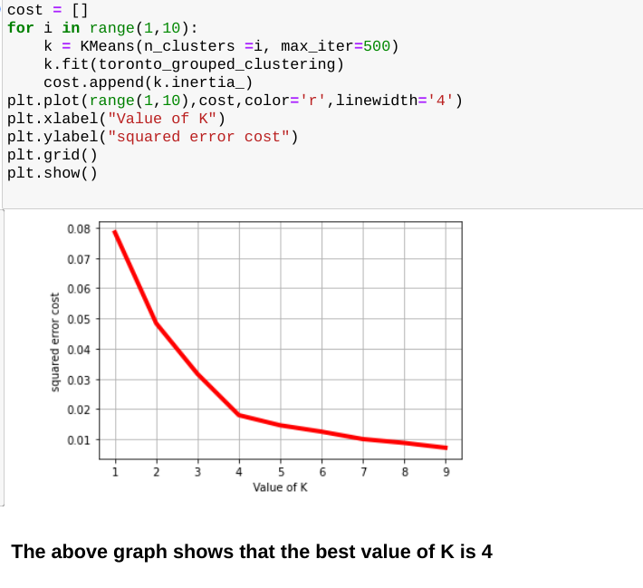
Elbow plot with mean squared error
35
25

Slide 13
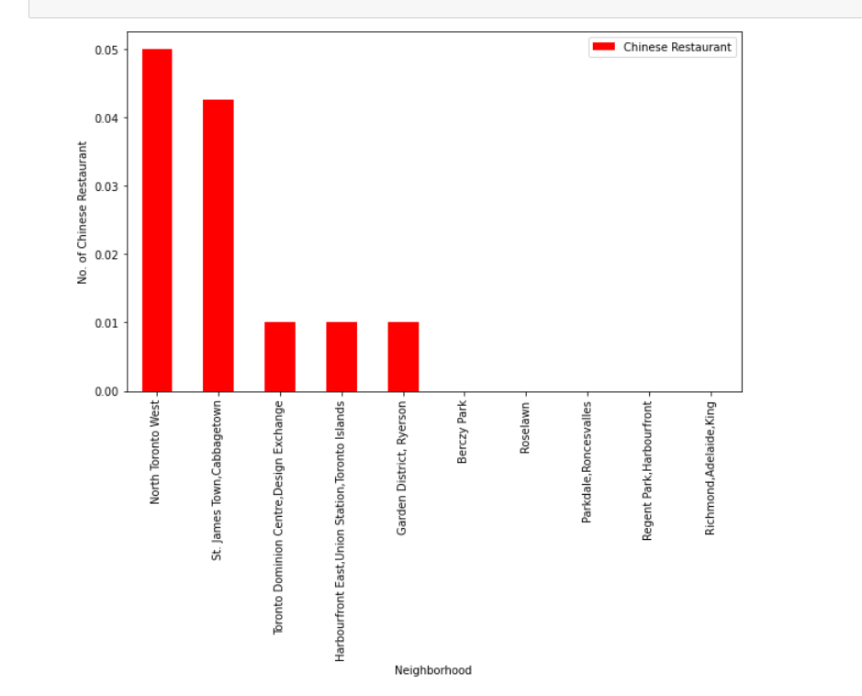
Bar chart
35
25

Slide 14
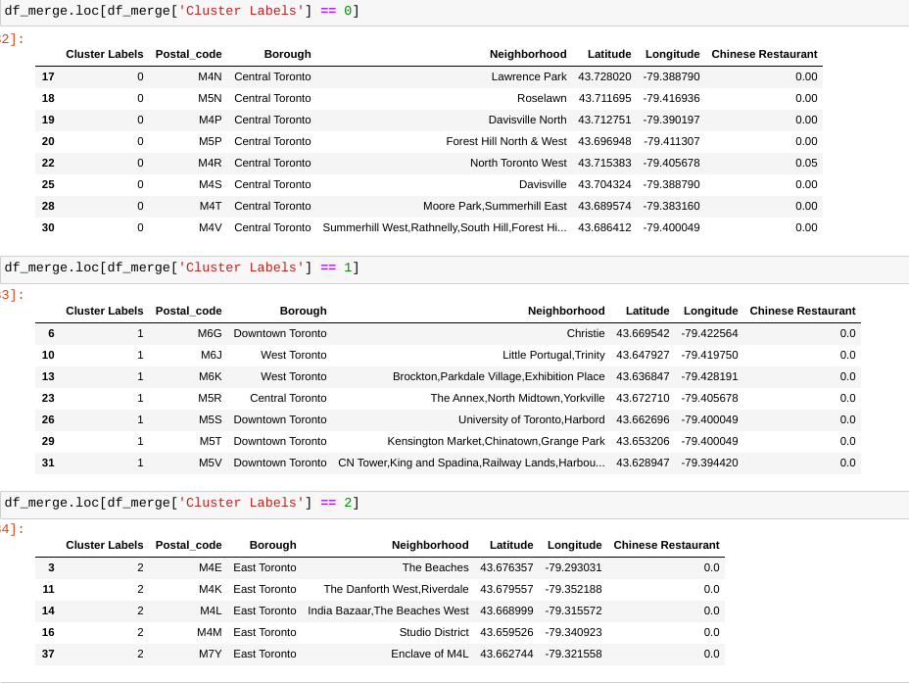
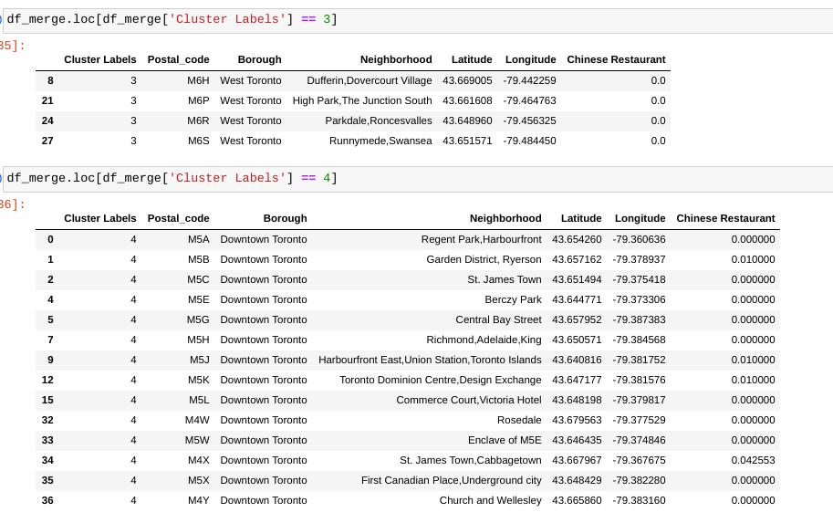
Examining the clusters
35
25

Slide 15
Insights
From above exploratory data analysis and clustering, following results can be seen:
North Toronto West has the highest number of chinese restaurants, it could be due to people having the taste of chinese food or more chinese people live in that area.
Cluster 4 has the most number of chinese restaurants in area, which could be due to high demand.
Chinese restaurant is the least popular food in clusters 1, 2 and 3
Toronto Dominion,Harbourfront, Garden District have average but same number of chinese restaurants around.
35
25

Slide 16
Conclusion
I would conclude here by saying that it would be best to open the chinese restaurant in Downtown Toronto M5J (Harbourfront East, Union Station, Toronto Island) as more
people would be visiting this area and also because there would be less competition, which would increase the chances of making it successful.
35
25

